Slide 1

Integrating AI into Software Testing
By Ankush Verma
Developer Intern,
ApMoSys Technologies
“Quality will never go out of fashion”

Slide 2

Introduction
Software testing has a crucial role in software engineering as it is essential for ensuring the quality, performance, security, and reliability of software systems.
By conducting testing, developers can identify and rectify any bugs, or defects in the software.
It improves overall functionality and makes sure that the software satisfies customer needs and expectations.
Planning
Preparing
Performing
Perfecting

Slide 3

Current Challenges In Software Testing
Challenges Related to Technology and Complexity
Rapid Pace of Development: Shorter development cycles and frequent updates make it difficult to keep testing aligned with the product.
Increasing Software Complexity: Modern applications are often complex, distributed systems that require sophisticated testing strategies.
Challenges Related to Resources and Processes
Test Data Management: Creating, maintaining, and securing high-quality test data is a persistent challenge.
Resource Constraints: Limited budget, personnel, and time often hinder comprehensive testing.
Challenges Related to Quality and User Experience
Security Testing: Identifying and mitigating vulnerabilities in complex software systems is crucial but challenging.
Performance Testing: Ensuring optimal performance under various load conditions is essential but resource-intensive.

Slide 4
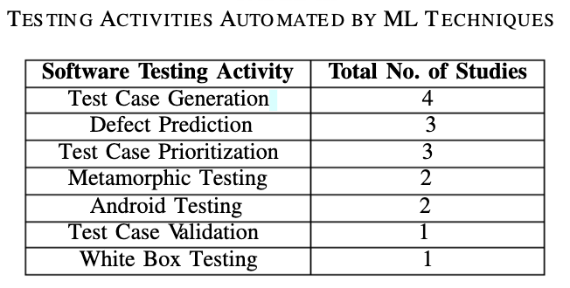
How AI Addresses Challenges:
Traditional test automation approaches are time-consuming and complex to implement. Apart from that, keeping pace with agile development is also a challenge as it requires rapid testing.
Q1: Does manual testing have drawbacks?
Manual testing has several drawbacks.
Some of the draw backs of manual testing are it is time-consuming, it does not cover all possible scenarios and use cases, it is costly, it susceptible to human errors and it cannot reproduce test cases accurately.
Solution: ML techniques can help to overcome the mentioned drawbacks of manual testing.
Q3: What software testing tasks can be automated by AI ?
Test results analysis.
Test case prioritization.
Defect prediction,
Test execution,
Test case evaluation,
6) Test case refinement,
7) Testing cost estimation, Test oracle construction, identification of metamorphic relations, and test case generation.

Slide 5
Q4: What techniques do researchers use to assess AI techniques when used in software testing?
Researchers consider different performance matrices to assess ML algorithms when used in software testing.
The performance matrices are cross-validation, accuracy, precision, recall, receiver operating characteristic (ROC) curve, area under the curve (AUC), and f1 score .
There are different software testing activities such as defect prediction, test case generation, test case prioritization, test optimization, API testing, etc that can be done using ML.
Bug Prediction using ML:
Bug prediction can be performed using ML.
ML algorithms analyze software code and predict the likelihood of future bugs in the code.
For performing bug prediction, ML models need to be trained on historical data from past software projects to identify patterns.
Once the model is trained, then it can predict the likelihood of bugs occurring in new code .
They used supervised ML algorithms to predict software fault based on historical data.
Test Case Generation using ML:
In software development Test case generation from the requirement specification document is one of the significant challenges in software testing.
Software test cases can be generated using ML.
ML model needs to be trained on a set of data where set of software features are considered as input and the corresponding test cases as output.
Finally, the model uses training data to generate new test cases .

Slide 6
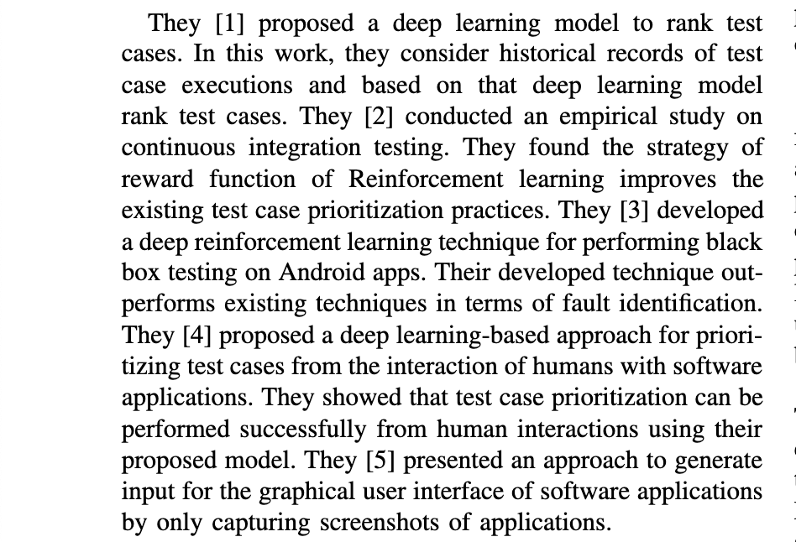
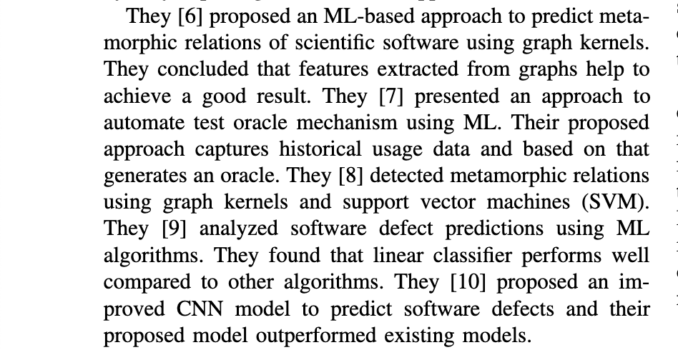
Test Case Prioritization using ML:
Test case prioritization can be performed using ML.
ML algorithms determine the most critical test cases to execute based on the likelihood of failure and the potential effect on the system.
For prioritizing test cases, an ML model needs to be trained on a set of labeled data, where a set of software features is considered input and the corresponding priority level of each test case as output.
Finally, the model uses this training data to priority new test cases based on their predicted priority level .

Slide 7
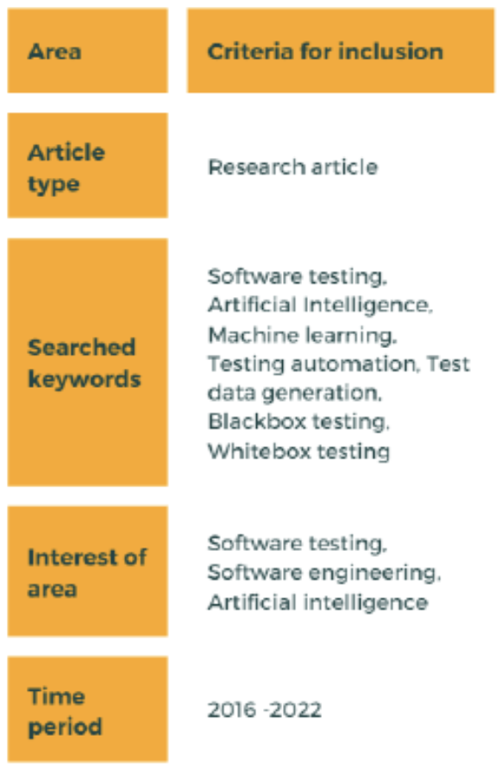
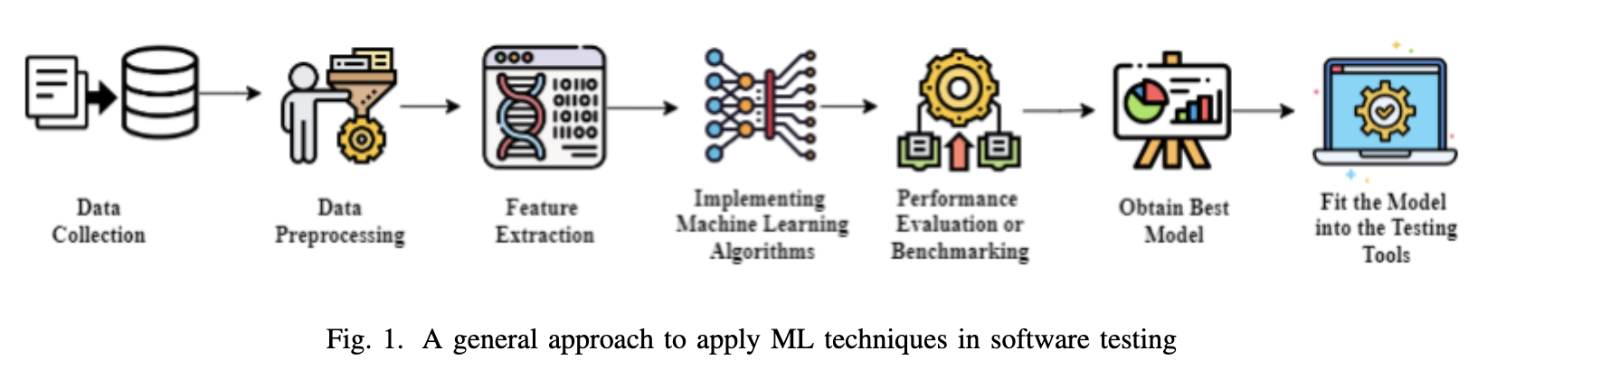

Slide 8
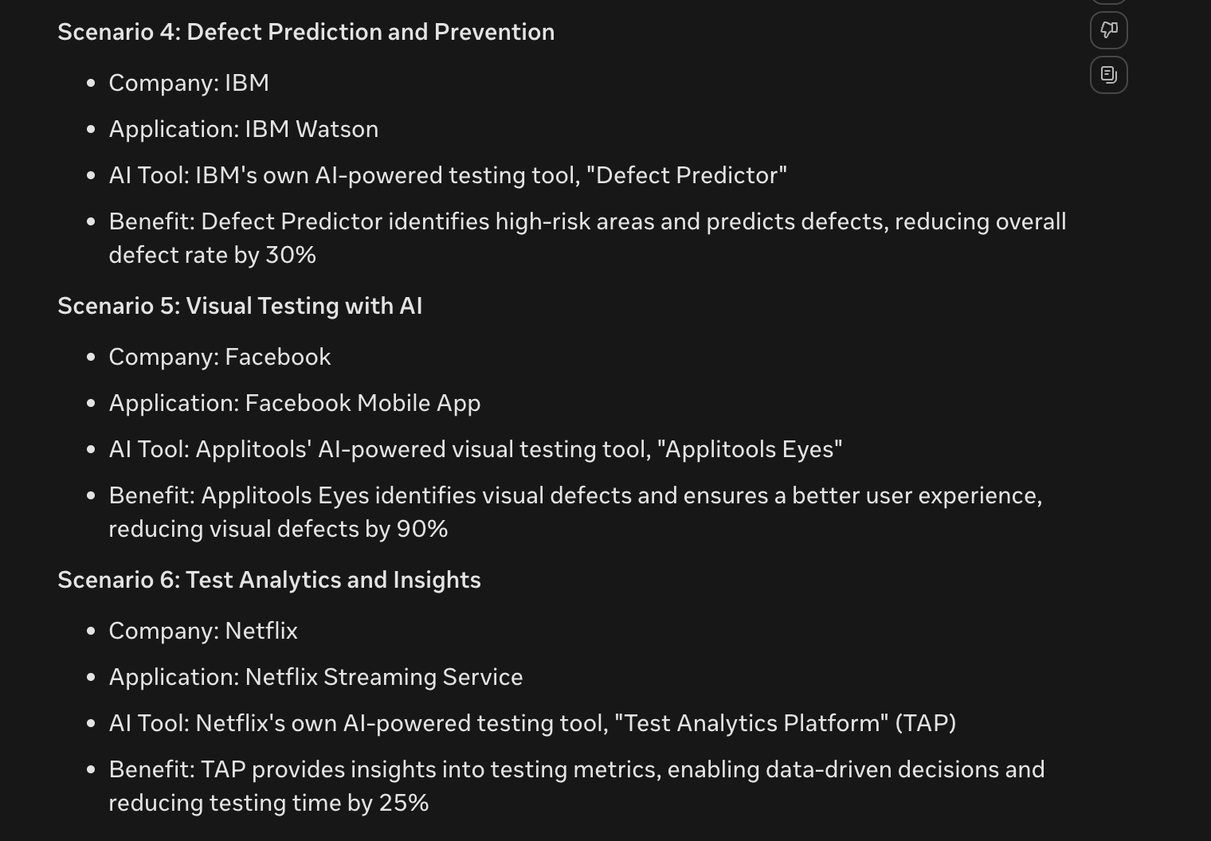
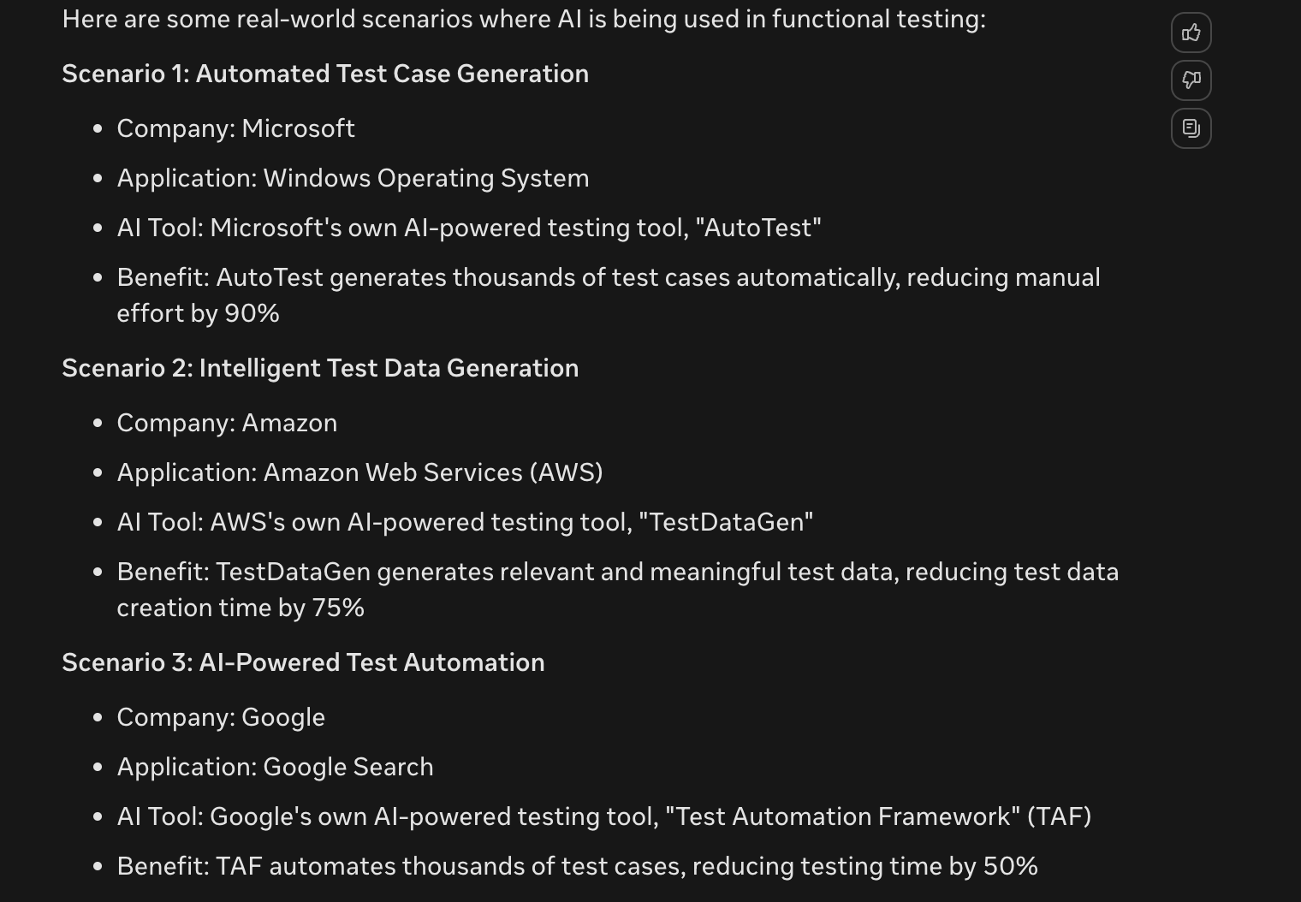
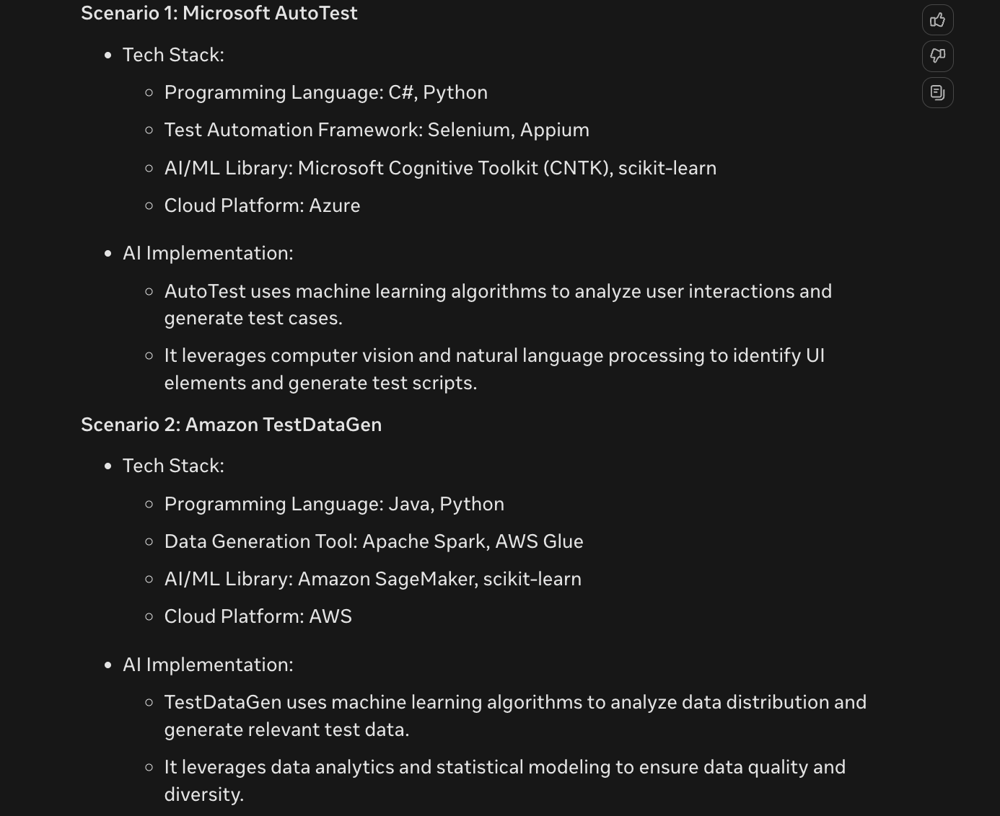
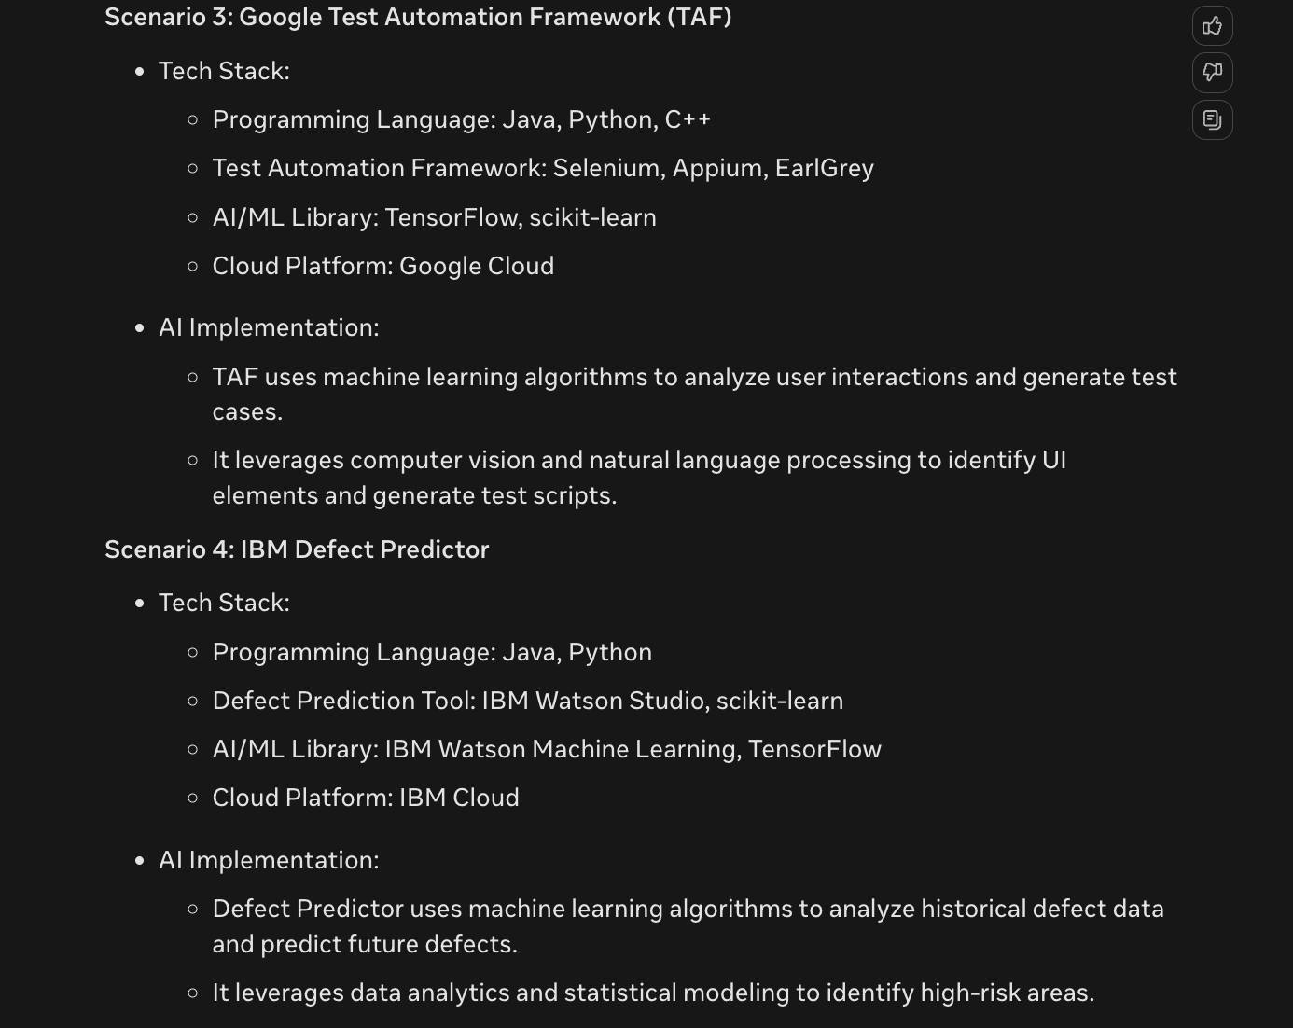

Slide 9
Functional Testing:
UI/Visual Testing: AI-powered tools like Applitools, Selenium, and Appium use Computer Vision and Machine Learning (ML) algorithms to perform visual testing, ensuring UI consistency and accuracy.
API Testing: AI-powered tools like Postman, SoapUI, and Rest-Assured use ML algorithms to generate API tests, ensuring API functionality and performance.
End-to-End Testing: AI-powered tools like TestComplete, Ranorex, and Selenium use ML and Deep Learning (DL) algorithms to perform end-to-end testing, simulating user interactions.
Machine Learning (ML): ML algorithms like decision trees, random forests, and support vector machines (SVMs) can be used for UI/visual testing, API testing, and end-to-end testing.
Automation Testing:
Test Automation Frameworks: AI-powered frameworks like Selenium, Appium, and TestComplete use ML and DL algorithms to automate testing.
AI-Driven Automation: AI algorithms like Reinforcement Learning (RL) and Generative Adversarial Networks (GANs) can be used to generate automation scripts, reducing manual effort.
Self-Healing Automation: AI-powered automation frameworks like Selenium and Appium use ML and DL algorithms to self-heal, reducing maintenance effort.
Deep Learning (DL): DL algorithms like convolutional neural networks (CNNs) and recurrent neural networks (RNNs) can be used for end-to-end testing and self-healing automation.
Reinforcement Learning (RL): RL algorithms like Q-learning and policy gradients can be used for AI-driven automation.
Generative Adversarial Networks (GANs): GANs can be used for generating automation scripts.

